Slide 1


Measuring Progress on Agricultural Transformation
Xinshen Diao, Karl Pauw, James Thurlow
IFPRI, Washington D.C.
USAID-BRFS Brownbag | February 26, 2024

Slide 2
Agricultural Transformation
Stylized stages
de Janvry and Sadoulet (2019)
Timmer (1988 and 2007)
Food System Expansion
More value added in the agrifood system is generated off the farm in processing, trade, and food services
Agric. Labor Productivity
Rising agricultural labor productivity supports transition to nonagricultural economy
Crop Diversification
Farm incomes increasingly come from higher value and/or more competitive crops
Agricultural Transformation
4
Staples Productivity
Productivity of staple food crops rises, allowing farmers to produce marketable surplus
3
dJS: Structural transformation
(step 5)
T: Integrating agric. in macroeconomy
(step 3)
2
T: Agric. as a contributor to growth
(step 2)
dJS: Rural transformation
(step 4)
1
dJS: Agric. transformation
(step 3)
T: Getting agric. moving (step 1)
dJS: Green revolution
(step 2)
Objectives
dJS: Asset building
(step 1)
New indicator:
Track countries’ progress in agricultural transformation
Annual estimates for all countries
Easy to explain and update
Key questions:
Where does a country stand today?
Is a country’s moving in the right direction?

Slide 3
Component Indicators
1
Staples Productivity
2
Farm Diversification
Indicator: Output value per hectare for staple crops (cereals, roots)
Period: 3-year average
Units: US$ in 2015 prices
Source: FAOSTAT
Indicator: Share of land allocated to food crops with above-average national or global productivity
Period: 3-year average
Units: Percentage
Source: FAOSTAT
2019-21
average
2019-21
average
3
Agric. Labor Productivity
4
Food System Expansion
Indicator: Log agric. GDP per worker
Period: Current year
Units: US$ in 2015 prices
Source: UNSD, ILO
Indicator: Off-farm agrifood system GDP as a share of total agrifood system GDP
Period: Current year
Units: Percentage
Source: IFPRI
$60,000
$1,000
2021
2021

Slide 4
Indicator 2 | Farm Diversification
Calculation:
Crop productivity = Output value per hectare for every crop in every country
Compare each crop’s productivity to…
Global average for that crop
Country average for all crops
Assign each crop to one of four categories
Crop diversification indicator:
Share of cultivated crop land allocated to crops that are above the global average productivity for that crop, OR above the national average productivity for all crops, OR both
Within-country comparison
Above global average productivity, but below national average productivity
Above global average productivity, and above national average productivity
Across country comparison
Below global average productivity, and below national average productivity
Below global average productivity, and above national average productivity

Slide 5
Preparing Indicators
Truncate at median value across UMICs and HICs for the period 2000-2010
(median threshold sets a target level for less developed countries and prevents outliers from distorting sample upwards)
(selecting a fixed historical target allows us to track countries’ current transformation relative to a fixed benchmark)
Normalize truncated indicators to 0-1 range
Step 1: Truncation
(e.g., Staples productivity in $ per hectare)
Step 2: Normalization
(e.g., Staples productivity in $ per hectare)
95% percentile
$1,524

Slide 6
Normalized Indicators
1
Staples Productivity
2
Farm Diversification
Value of output per hectare for staple food crops
(2019-21 average)
Share of crop and livestock food-related output from high value activities
(2019-21 average)
3
Agricultural Labor Productivity
4
Food System Expansion
Log agricultural GDP per worker
(2021)
Off-farm agrifood system GDP as a share of total agrifood system GDP
(2021)

Slide 7
Composite Indicator
Add normalized indicators together assuming equal weights:
¼
Staples Productivity
Agricultural Transformation Index (ATI)
(equally weighted composite)
¼
ATI in 2021
Farm Diversification
¼
Agricultural Labor Productivity
¼
Food System Expansion

Slide 8
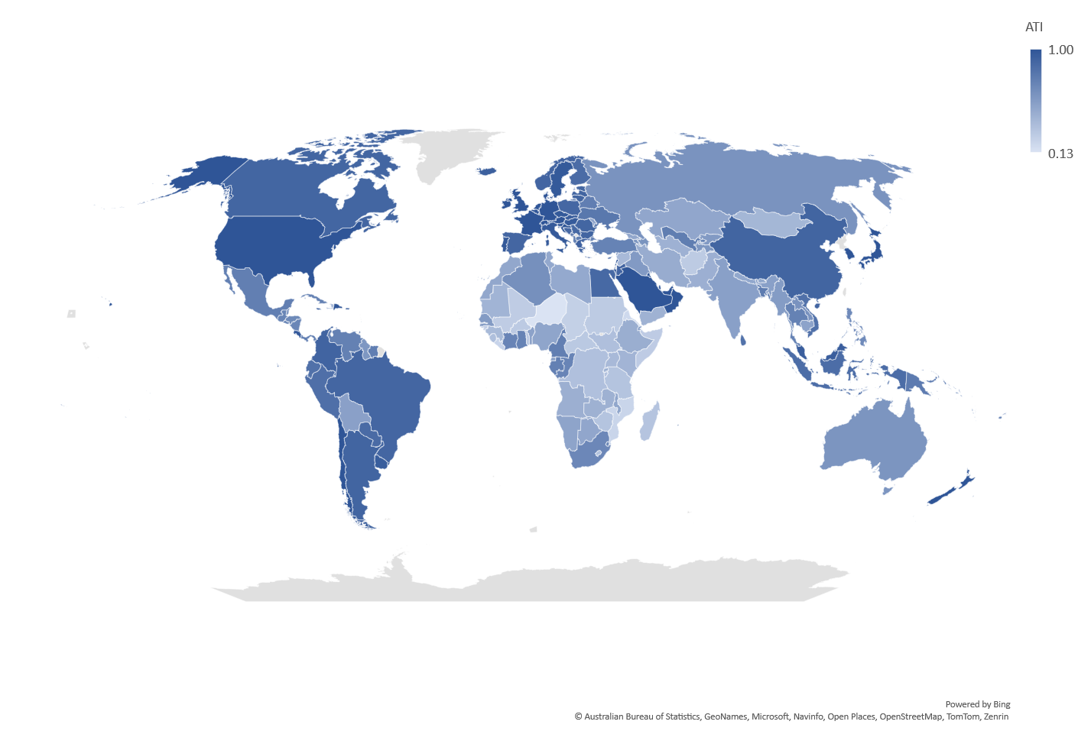
Country ATI Scores ₍₂₀₂₁₎
Agricultural Transformation Index (ATI)
(182 countries in 2021)
Agricultural Transformation Index (ATI)
(182 countries in 2021)

Slide 9
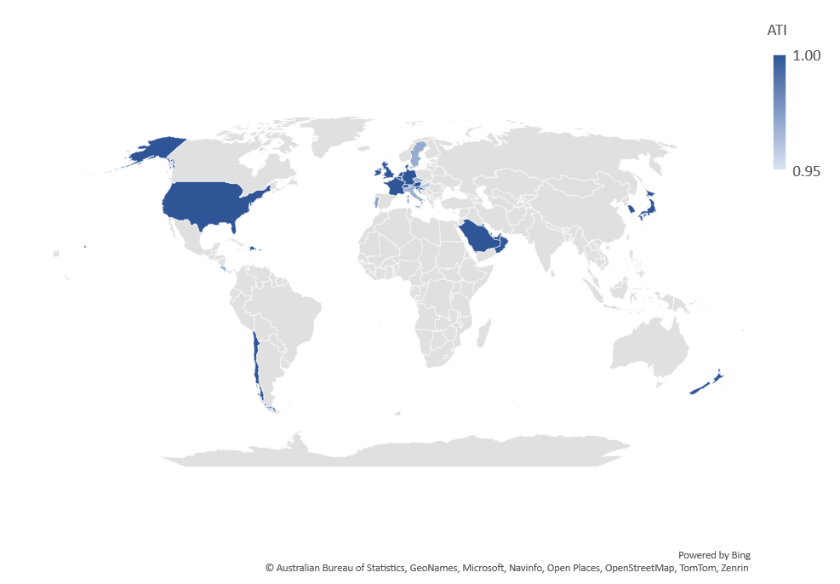
Highest Ranked Countries ₍₂₀₂₁₎
Austria
Belgium
Chile
Costa Rica
Croatia
Czech Republic
Denmark
Dominican Republic
France
Germany
Hong Kong SAR, China
Hungary
Ireland
Israel
Italy
Japan
Korea, Rep.
Kuwait
Lebanon
Luxembourg
Netherlands
New Zealand
Oman
Portugal
Puerto Rico
Qatar
Saudi Arabia
Singapore
Slovenia
Sweden
Switzerland
United Arab Emirates
United Kingdom
United States
UMICs in red
34 countries had ATI scores of 0.95 or higher in 2021
(out of 182 countries)

Slide 10
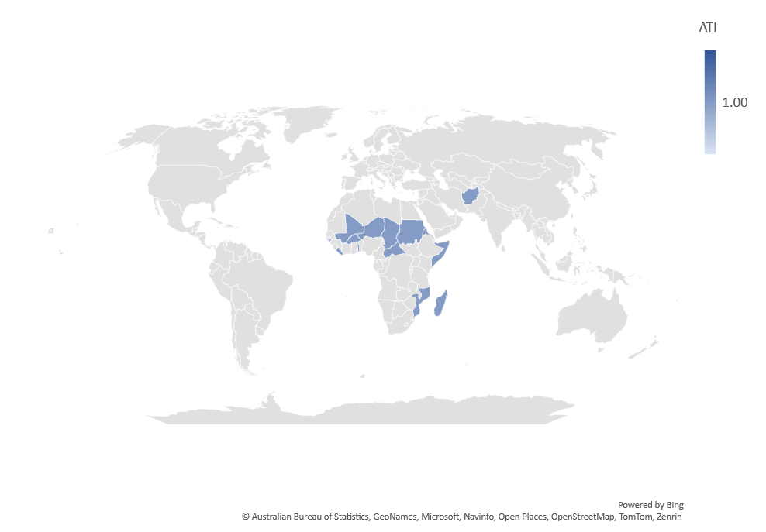
Lowest Ranked Countries ₍₂₀₂₁₎
Lowest Ranked in 2021
(out of 182 countries)
15 lowest-ranked countries in 2021
(out of 182 countries)
 | Country |  | ATI
182 | Niger | LIC | 0.14
181 | Eritrea | LIC | 0.20
180 | Mozambique | LIC | 0.23
179 | Liberia | LIC | 0.25
178 | Chad | LIC | 0.26
177 | Gambia, The | LIC | 0.27
176 | Somalia | LIC | 0.28
175 | Sudan | LIC | 0.28
174 | Mali | LIC | 0.29
173 | Guinea-Bissau | LIC | 0.29
172 | Burkina Faso | LIC | 0.30
171 | Afghanistan | LIC | 0.30
170 | C.A. Republic | LIC | 0.30
169 | Togo | LIC | 0.32
168 | Zimbabwe | LMIC | 0.34

Slide 11
Transformation, Poverty, and Undernourishment
Poverty is higher in countries with low ATIs
(137 countries | most recent year with poverty estimate)
Hunger is also higher in countries with low ATIs
(137 countries in 2021)

Slide 12
FTF Countries ₍₂₀₂₁₎
ATI scores in 2021
(rank out of 182)
ATI scores in 2021
(out of 182 countries)
 | Country |  | ATI
83 | Bangladesh | LMIC | 0.76
99 | Guatemala | UMIC | 0.73
100 | Ghana | LMIC | 0.72
105 | Honduras | LMIC | 0.70
120 | Senegal | LMIC | 0.60
131 | Malawi | LIC | 0.55
132 | Nepal | LMIC | 0.55
133 | Ethiopia | LIC | 0.54
137 | Nigeria | LMIC | 0.54
144 | Rwanda | LIC | 0.51
150 | Zambia | LMIC | 0.47
152 | Kenya | LMIC | 0.44
154 | Uganda | LIC | 0.44
161 | DRC | LIC | 0.38
164 | Madagascar | LIC | 0.36
166 | Tanzania | LMIC | 0.34
174 | Mali | LIC | 0.29
179 | Liberia | LIC | 0.25
180 | Mozambique | LIC | 0.23
182 | Niger | LIC | 0.14

Slide 13
ATI Change ₍₂₀₀₀₋₂₀₂₁₎
On average, ATI rose across all country income groups during 2000-2021
Largest gains for the middle-income country groups
Low-income countries are lagging, mainly due to limited crop diversification
Agricultural Transformation Index (ATI)
(182 countries across 2000-2021)
Contribution to point change in ATI
(182 countries across 2000-2021)

Slide 14
ATI Change ₍₂₀₀₀₋₂₀₂₁₎
All countries
FTF countries
2000
+0.11
2021

Slide 15
Summary
ATI combines key dimensions of agric. transformation
Does not prescribe a single linear pathway
Easy to update (and explain)
Generally, a plausible ranking of countries
Small differences between countries should not be overinterpreted
FTF countries have made progress over the last decade
ATI scores are rising in most countries
Five countries have stalled or are backsliding (e.g., DRC, Liberia, Mali, Nigeria and Uganda)
Most remain amongst the least transformed

Slide 16
Country Ranking ₍₂₀₂₁₎
Rank | Country | ATI | Rank | Country | ATI | Rank | Country | ATI | Rank | Country | ATI
1 | Austria | 1.000 | 30 | Slovak Republic | 0.997 | 59 | Finland | 0.887 | 88 | New Caledonia | 0.754
1 | Belgium | 1.000 | 31 | Hungary | 0.988 | 60 | Cyprus | 0.881 | 89 | Nicaragua | 0.752
1 | Chile | 1.000 | 32 | Portugal | 0.979 | 61 | Egypt, Arab Rep. | 0.878 | 90 | Cote d'Ivoire | 0.752
1 | Croatia | 1.000 | 33 | Costa Rica | 0.975 | 62 | Bahrain | 0.876 | 91 | El Salvador | 0.752
1 | Czech Republic | 1.000 | 34 | Lebanon | 0.974 | 63 | Jamaica | 0.864 | 92 | Turkey | 0.752
1 | Denmark | 1.000 | 35 | Iceland | 0.970 | 64 | Ecuador | 0.854 | 93 | Gabon | 0.750
1 | Dominican Republic | 1.000 | 36 | Uruguay | 0.968 | 65 | Indonesia | 0.852 | 94 | Suriname | 0.750
1 | France | 1.000 | 37 | Norway | 0.961 | 66 | West Bank and Gaza | 0.848 | 95 | Venezuela, RB | 0.745
1 | Germany | 1.000 | 38 | Greece | 0.960 | 67 | Peru | 0.839 | 96 | South Africa | 0.739
1 | Hong Kong SAR, China | 1.000 | 39 | Malaysia | 0.957 | 68 | Ukraine | 0.832 | 97 | Cuba | 0.732
1 | Ireland | 1.000 | 40 | Israel | 0.955 | 69 | Vietnam | 0.827 | 98 | Congo, Rep. | 0.731
1 | Italy | 1.000 | 41 | Argentina | 0.950 | 70 | St. V. and the Grenadines | 0.821 | 99 | Guatemala | 0.730
1 | Japan | 1.000 | 42 | Bulgaria | 0.950 | 71 | Sri Lanka | 0.820 | 100 | Ghana | 0.721
1 | Korea, Rep. | 1.000 | 43 | Latvia | 0.949 | 72 | Trinidad and Tobago | 0.813 | 101 | Samoa | 0.715
1 | Luxembourg | 1.000 | 44 | Lithuania | 0.947 | 73 | St. Lucia | 0.806 | 102 | Eswatini | 0.712
1 | Netherlands | 1.000 | 45 | Poland | 0.943 | 74 | Bahamas, The | 0.805 | 103 | Maldives | 0.710
1 | New Zealand | 1.000 | 46 | Estonia | 0.939 | 75 | Malta | 0.804 | 104 | Philippines | 0.699
1 | Puerto Rico | 1.000 | 47 | Spain | 0.939 | 76 | Belarus | 0.794 | 105 | Honduras | 0.699
1 | Qatar | 1.000 | 48 | Brazil | 0.938 | 77 | North Macedonia | 0.786 | 106 | Fiji | 0.696
1 | Saudi Arabia | 1.000 | 49 | Jordan | 0.934 | 78 | Panama | 0.779 | 107 | Sao Tome and Principe | 0.693
1 | Singapore | 1.000 | 50 | Bosnia and Herzegovina | 0.929 | 79 | French Polynesia | 0.779 | 108 | Tonga | 0.683
1 | Slovenia | 1.000 | 51 | Canada | 0.927 | 80 | Mexico | 0.777 | 109 | Algeria | 0.673
1 | Sweden | 1.000 | 52 | Romania | 0.922 | 81 | Montenegro | 0.768 | 110 | Brunei Darussalam | 0.669
1 | Switzerland | 1.000 | 53 | Serbia | 0.913 | 82 | Papua New Guinea | 0.767 | 111 | Azerbaijan | 0.660
1 | United Arab Emirates | 1.000 | 54 | Paraguay | 0.910 | 83 | Bangladesh | 0.764 | 112 | Russian Federation | 0.648
1 | United Kingdom | 1.000 | 55 | Colombia | 0.907 | 84 | Albania | 0.762 | 113 | Belize | 0.645
1 | United States | 1.000 | 56 | China | 0.905 | 85 | Uzbekistan | 0.761 | 114 | Tajikistan | 0.639
28 | Kuwait | 0.999 | 57 | Mauritius | 0.900 | 86 | Thailand | 0.761 | 115 | Armenia | 0.638
29 | Oman | 0.999 | 58 | Barbados | 0.890 | 87 | Cameroon | 0.759 | 116 | Lao PDR | 0.627

Slide 17
Country Ranking ₍₂₀₂₁₎
Rank | Country | ATI | Rank | Country | ATI | Rank | Country | ATI
117 | Australia | 0.625 | 146 | Pakistan | 0.497 | 175 | Sudan | 0.284
118 | Kyrgyz Republic | 0.612 | 147 | Iran, Islamic Rep. | 0.479 | 176 | Somalia | 0.280
119 | Iraq | 0.606 | 148 | Turkmenistan | 0.476 | 177 | Gambia, The | 0.274
120 | Senegal | 0.603 | 149 | Angola | 0.474 | 178 | Chad | 0.256
121 | Solomon Islands | 0.599 | 150 | Zambia | 0.473 | 179 | Liberia | 0.248
122 | Guyana | 0.598 | 151 | Mauritania | 0.445 | 180 | Mozambique | 0.235
123 | India | 0.594 | 152 | Kenya | 0.442 | 181 | Eritrea | 0.195
124 | Myanmar | 0.584 | 153 | Yemen, Rep. | 0.440 | 182 | Niger | 0.136
125 | Bolivia | 0.572 | 154 | Uganda | 0.435
126 | Benin | 0.562 | 155 | Mongolia | 0.422
127 | Djibouti | 0.559 | 156 | Haiti | 0.420
128 | Equatorial Guinea | 0.558 | 157 | Guinea | 0.416
129 | Moldova | 0.556 | 158 | Sierra Leone | 0.410
130 | Cambodia | 0.550 | 159 | Syrian Arab Republic | 0.406
131 | Malawi | 0.549 | 160 | Cabo Verde | 0.400
132 | Nepal | 0.547 | 161 | Congo, Dem. Rep. | 0.380
133 | Ethiopia | 0.545 | 162 | Burundi | 0.379
134 | Namibia | 0.542 | 163 | South Sudan | 0.367
135 | Georgia | 0.537 | 164 | Madagascar | 0.363
136 | Comoros | 0.537 | 165 | Lesotho | 0.363
137 | Nigeria | 0.535 | 166 | Tanzania | 0.342
138 | Vanuatu | 0.529 | 167 | Timor-Leste | 0.338
139 | Bhutan | 0.527 | 168 | Zimbabwe | 0.336
140 | Botswana | 0.520 | 169 | Togo | 0.318
141 | Kazakhstan | 0.513 | 170 | Central African Republic | 0.303
142 | Tunisia | 0.510 | 171 | Afghanistan | 0.303
143 | Morocco | 0.510 | 172 | Burkina Faso | 0.296
144 | Rwanda | 0.509 | 173 | Guinea-Bissau | 0.287
145 | Libya | 0.502 | 174 | Mali | 0.286

Slide 18
Annex | Sources of ATI Change in FTF Countries ₍₂₀₀₀₋₂₀₂₁₎
ATI Score in 2021 and change during 2000-2021

Slide 19
Bangladesh | Country ATI Profile ₍₂₀₀₀₋₂₀₂₁₎
Country estimates for 2021
(182 countries)
Global Ranking in 2021
(out of 182 countries)
Agricultural Transformation Index (ATI)
(equally weighted composite)

Slide 20
DRC | Country ATI Profile ₍₂₀₀₀₋₂₀₂₁₎
Country estimates for 2021
(182 countries)
Global Ranking in 2021
(out of 182 countries)
Agricultural Transformation Index (ATI)
(equally weighted composite)

Slide 21
Ethiopia | Country ATI Profile ₍₂₀₀₀₋₂₀₂₁₎
Country estimates for 2021
(182 countries)
Global Ranking in 2021
(out of 182 countries)
Agricultural Transformation Index (ATI)
(equally weighted composite)

Slide 22
Ghana | Country ATI Profile ₍₂₀₀₀₋₂₀₂₁₎
Country estimates for 2021
(182 countries)
Global Ranking in 2021
(out of 182 countries)
Agricultural Transformation Index (ATI)
(equally weighted composite)

Slide 23
Guatemala | Country ATI Profile ₍₂₀₀₀₋₂₀₂₁₎
Country estimates for 2021
(182 countries)
Global Ranking in 2021
(out of 182 countries)
Agricultural Transformation Index (ATI)
(equally weighted composite)

Slide 24
Honduras | Country ATI Profile ₍₂₀₀₀₋₂₀₂₁₎
Country estimates for 2021
(182 countries)
Global Ranking in 2021
(out of 182 countries)
Agricultural Transformation Index (ATI)
(equally weighted composite)

Slide 25
Kenya | Country ATI Profile ₍₂₀₀₀₋₂₀₂₁₎
Country estimates for 2021
(182 countries)
Global Ranking in 2021
(out of 182 countries)
Agricultural Transformation Index (ATI)
(equally weighted composite)

Slide 26
Liberia | Country ATI Profile ₍₂₀₀₀₋₂₀₂₁₎
Country estimates for 2021
(182 countries)
Global Ranking in 2021
(out of 182 countries)
Agricultural Transformation Index (ATI)
(equally weighted composite)

Slide 27
Mali | Country ATI Profile ₍₂₀₀₀₋₂₀₂₁₎
Country estimates for 2021
(182 countries)
Global Ranking in 2021
(out of 182 countries)
Agricultural Transformation Index (ATI)
(equally weighted composite)

Slide 28
Madagascar | Country ATI Profile ₍₂₀₀₀₋₂₀₂₁₎
Country estimates for 2021
(182 countries)
Global Ranking in 2021
(out of 182 countries)
Agricultural Transformation Index (ATI)
(equally weighted composite)

Slide 29
Malawi | Country ATI Profile ₍₂₀₀₀₋₂₀₂₁₎
Country estimates for 2021
(182 countries)
Global Ranking in 2021
(out of 182 countries)
Agricultural Transformation Index (ATI)
(equally weighted composite)

Slide 30
Mozambique | Country ATI Profile ₍₂₀₀₀₋₂₀₂₁₎
Country estimates for 2021
(182 countries)
Global Ranking in 2021
(out of 182 countries)
Agricultural Transformation Index (ATI)
(equally weighted composite)

Slide 31
Nepal | Country ATI Profile ₍₂₀₀₀₋₂₀₂₁₎
Country estimates for 2021
(182 countries)
Global Ranking in 2021
(out of 182 countries)
Agricultural Transformation Index (ATI)
(equally weighted composite)

Slide 32
Niger | Country ATI Profile ₍₂₀₀₀₋₂₀₂₁₎
Country estimates for 2021
(182 countries)
Global Ranking in 2021
(out of 182 countries)
Agricultural Transformation Index (ATI)
(equally weighted composite)

Slide 33
Nigeria | Country ATI Profile ₍₂₀₀₀₋₂₀₂₁₎
Country estimates for 2021
(182 countries)
Global Ranking in 2021
(out of 182 countries)
Agricultural Transformation Index (ATI)
(equally weighted composite)

Slide 34
Senegal | Country ATI Profile ₍₂₀₀₀₋₂₀₂₁₎
Country estimates for 2021
(182 countries)
Global Ranking in 2021
(out of 182 countries)
Agricultural Transformation Index (ATI)
(equally weighted composite)

Slide 35
Tanzania | Country ATI Profile ₍₂₀₀₀₋₂₀₂₁₎
Country estimates for 2021
(182 countries)
Global Ranking in 2021
(out of 182 countries)
Agricultural Transformation Index (ATI)
(equally weighted composite)

Slide 36
Uganda | Country ATI Profile ₍₂₀₀₀₋₂₀₂₁₎
Country estimates for 2021
(182 countries)
Global Ranking in 2021
(out of 182 countries)
Agricultural Transformation Index (ATI)
(equally weighted composite)

Slide 37
Rwanda | Country ATI Profile ₍₂₀₀₀₋₂₀₂₁₎
Country estimates for 2021
(182 countries)
Global Ranking in 2021
(out of 182 countries)
Agricultural Transformation Index (ATI)
(equally weighted composite)

Slide 38
Zambia | Country ATI Profile ₍₂₀₀₀₋₂₀₂₁₎
Country estimates for 2021
(182 countries)
Global Ranking in 2021
(out of 182 countries)
Agricultural Transformation Index (ATI)
(equally weighted composite)

